Slide 1
Illusion
Jialu Zhang

Slide 2
Have you ever imagine yourself as a character
in a movie?

Slide 3

Inspiration
Resource: https://en.wikipedia.org/wiki/Now_You_See_Me_2

Slide 4
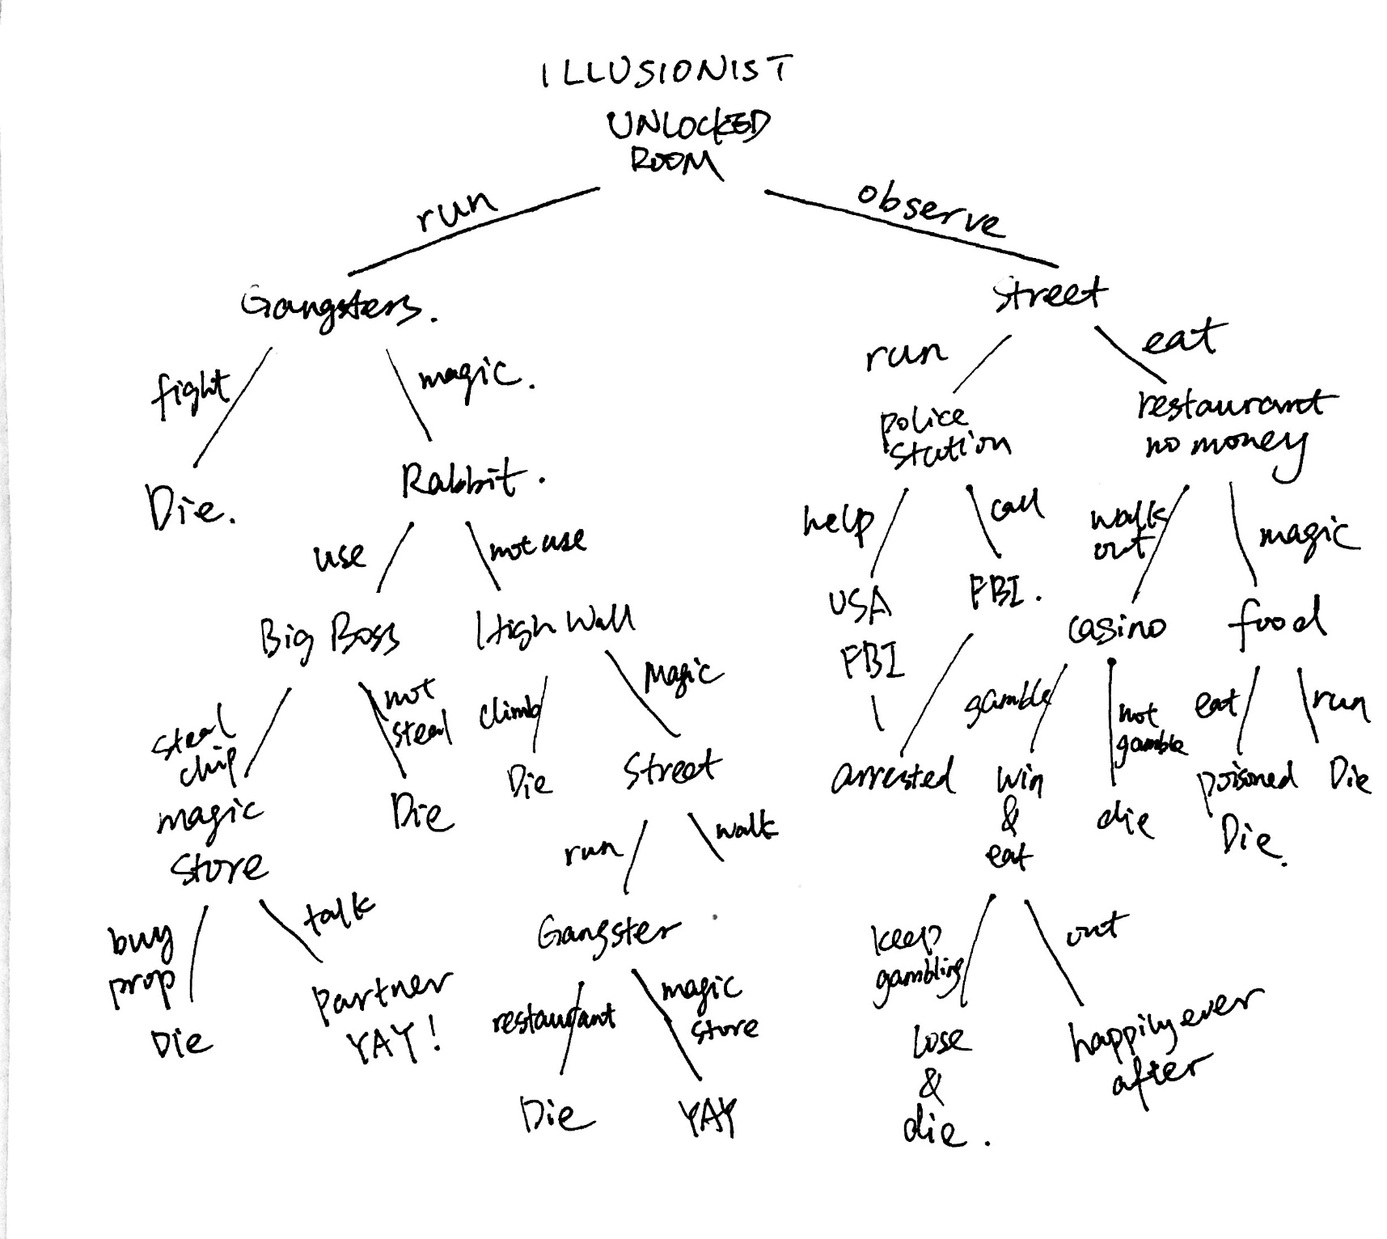
Flow Chart

